Slide 1
Smart Traffic Navigation System for Fault-Tolerant Edge Computing of IoV Team Members: Member 1: D.Akhil – CSE23413 Member 2: D.Uday kumar -CSE23655 Member 3:Sholingaram Hemanth-CSE23446 Member 4: P.BHANU PRAKASH REDDY-CSE23663

Slide 2
The Traffic Conundrum: Why We Need Smarter Roads
Traffic congestion is a massive headache for everyone. But it's more than just annoying delays; it leads to:
Wasted fuel and increased pollution.
More accidents due to chaotic flow.
Slow emergency response times.
We need quick decisions to manage traffic, and traditional systems are too slow.
That’s where 'edge computing' comes in, bringing the processing power closer to the action.

Slide 3
we aim to build a smart traffic system using edge computing that helps vehicles make quick and safe decisions in real-time, even if some sensors or parts fail. Traditional traffic systems are slow and depend on the cloud, which causes delays. Our system uses ESP32 boards on vehicles to process sensor data instantly using spiking neural networks (snns), which work like a brain. It can detect obstacles, reroute if needed, and keep working even during hardware faults. This makes traffic flow smarter, safer, and more reliable. Source Material: Based on IEEE research on neuromorphic edge computing and traffic task scheduling.
Problem statement

Slide 4
Why Edge Computing?
Low Latency: Autonomous vehicles and intelligent traffic systems require decisions to be made in real-time to ensure safety and efficiency. Edge computing processes data closer to the source (the vehicle itself or roadside units).
Real-Time Decision-Making: Critical tasks like collision avoidance and traffic light optimization cannot tolerate delays from the cloud. Edge nodes enable instantaneous local decisions.
Why Edge over Fog?
Edge computing provides the lowest latency, which is essential for safety-critical functions. Fog nodes provide an intermediary layer for localized coordination, while the cloud handles long-term data analysis and large-scale infrastructure management.

Slide 5
Literature Review:
Insights from Neuromorphic Edge Computing
Key Findings: Research, particularly from an IEEE paper on neuromorphic edge computing, highlights the potential of brain-inspired systems for IoV.
Spiking Neural Networks (SNNs): SNNs process information in a temporal, event-driven manner, making them highly energy-efficient and suitable for real-time edge processing.
Dopamine (DA) based learning: This reinforcement learning mechanism mimics the human brain's reward system, enabling SNNs to learn optimal navigation strategies dynamically.
Fault Tolerance: Existing research focuses on hardware-level fault tolerance, but there is a gap in dynamic, software-defined fault-tolerant routing for traffic data.
Gaps in Existing Work: Most models are simplified simulations or focus on a single aspect (e.g., fault tolerance or learning), lacking an integrated, end-to-end solution.

Slide 6
Fault Tolerance: Keeping Traffic Flowing
What if a sensor breaks or a communication link goes down? Our system is designed to handle it:
System resilience: It won't crash just because one part fails.
Bypass routing: If a path is blocked, traffic is automatically rerouted around the problem area.
This ensures continuous operation, which is critical for maintaining safe and efficient traffic flow.

Slide 7
Method | What It Does Well | What It Lacks
FORESAM | Schedules tasks based on multiple factors like priority and deadlines | Rejects tasks greedily, lacks fault-handling capability
DATE-V | Uses reinforcement learning for context-aware decisions | Has overhead due to task replication
Traditional SNNs | Mimics how the brain works, good for intelligent decision making | Doesn’t handle edge-level faults or routing issues
FTSP-KMCR | Tries to build fault-tolerant routing algorithms in edge environments | Routing is complex and not scalable for many edge devices
State of the Art

Slide 8
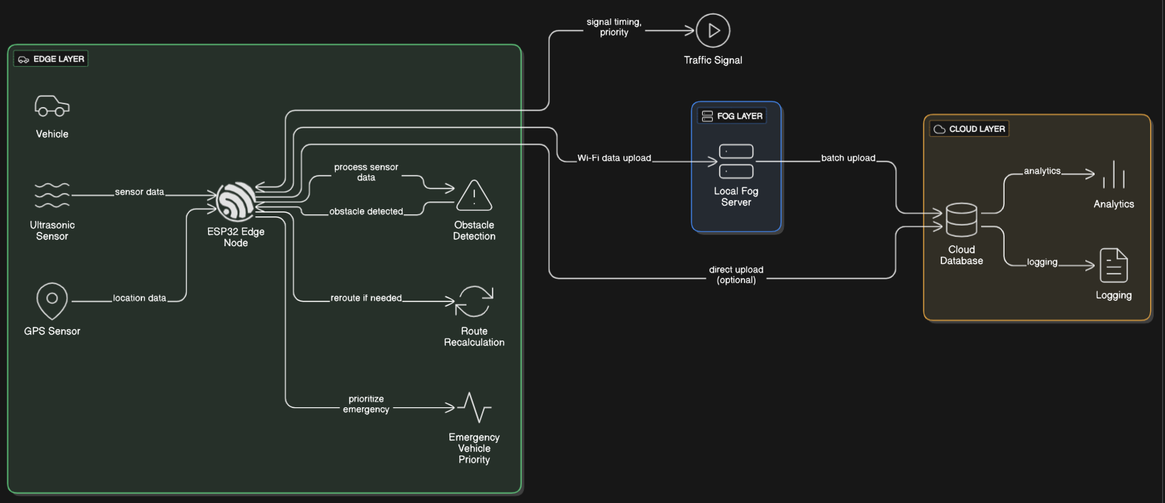
The Architecture Diagram

Slide 9
Team Roles & Responsibilities
D. Akhil – SUMO Simulation Using SUMO software to make traffic maps and show how vehicles move. Creating routes for testing and giving vehicle movement data to the team.
D. Uday Kumar – SNN Model Development Building a brain-like model (SNN) that helps the vehicle decide whether to go, stop, or wait. Training the model to learn from different traffic situations.
Sholingaram Hemanth – Hardware & Fault Testing Testing the model on real hardware using an FPGA board. Writing code to control how data flows. Breaking parts on purpose to check if the system still works properly.
P. Bhanu Prakash Reddy – Integration & Evaluation Connecting the simulation, model, and hardware together. Checking how fast and accurate the system is. Helping prepare the review report and final presentation.

Slide 10
Conclusion: A smarter, safer future for roads we will develop a smart traffic navigation system that leverages fault-tolerant edge computing and brain-inspired SNNS. Real-world impact: less traffic, reduced pollution, and faster emergency services. Future enhancements: integrating with autonomous vehicles, dynamic pricing for routes, and predictive maintenance for infrastructure. Our project lays the groundwork for truly intelligent transportation systems of the future.
THANK YOU
Any Queries ?

